Slide 1
Linear Algebra
Lecture 27

Slide 2
Vector Spaces

Slide 3
Applications to
Difference
Equations

Slide 4
Discrete Time Signal
Let S is the space of discrete-time signals. A signal in S is a function defined only on the integers and is visualized as a sequence of numbers, say, {y_{k}}. …

Slide 5
Digital signals obviously arise in electrical and control systems engineering, but discrete-data sequences are also generated in biology, physics, economics, demography and many other areas, wherever a process is measured, or sampled, at discrete time intervals. …

Slide 6
When a process begins at a specific time, it is sometimes convenient to write a signal as a sequence of the form
(y₀, y₁, y₂, …)
The terms y_{k} for k<0 either are assumed to be zero or are simply omitted.

Slide 7
Example 1
The crystal clear sounds from a compact disc player are produced from music that has been sampled at the rate of 44,100 times per second. At each measurement, the amplitude of the music signal is recorded as a number, say, y_{k}. …

Slide 8
The original music is composed of many different sounds of varying frequencies, yet the sequence {y_{k}} contains enough information to reproduce all the frequencies in the sound up to about 20,000 cycles per second, higher than the human ear can sense.

Slide 9
Linear Independence
in the Space S
of Signals

Slide 10
Example 2
Verify that 1^{k}, (-2)^{k} and 3^{k} are linearly independent signals.

Slide 11
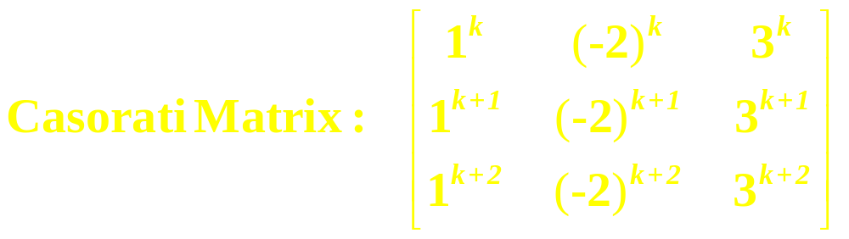
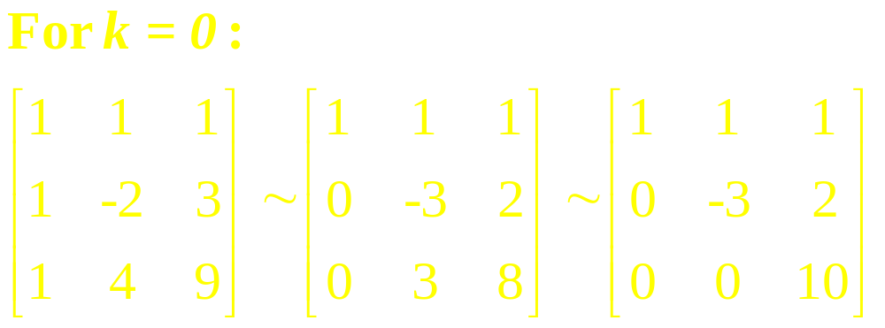
Solution
…

Slide 12
continued
The Casorati matrix is invertible for k = 0.
So 1^{k}, (-2)^{k} and 3^{k} are linearly independent.

Slide 13
Definition
Given scalars a₀, … , a_{n}, with a₀ and a_{n} nonzero, and given a signal {z_{k}}, the equation
is called a linear difference equation (or linear recurrence relation) of order n. …

Slide 14
continued
For simplicity, a₀ is often taken equal to 1. If {z_{k}} is the zero sequence, the equation is homogeneous; otherwise, the equation is non-homogeneous.

Slide 15
Examples

Slide 16
Note
In general, a nonzero signal r^{k} satisfies the homogeneous difference equation
if and only if r is a root of the auxiliary equation …

Slide 17
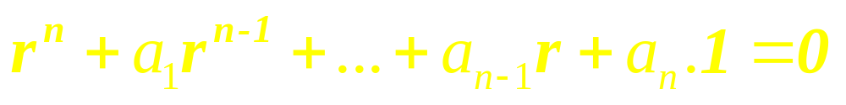
When the auxiliary equation has a complex root, the difference equation has solutions of the form s^{k} cos kw and s^{k} sin kw, for constants s and w.

Slide 18
Solution Sets of
Linear Difference
Equations

Slide 19

Given a₁, … , a_{n}, consider the mapping T: S S that transforms a signal {y_{k}}into a signal {w_{k}} given by
It is readily checked that T is a linear transformation. …

Slide 20
This implies that the solution set of the homogeneous equation
is the kernel of T (the set of signals that T maps into the zero signal) and hence the solution set is a subspace of S.

Slide 21
Any linear combination of solutions is again a solution.

Slide 22

Theorem
If a_{n} 0 and if {z_{k}} is given, the equation
y_{k+n}+a₁y_{k+n-1}+…+a_{n-1}y_{k+1}+a_{n}y_{k}=z_{k},
for all k has a unique solution whenever y₀,…, y_{n-1} are specified.

Slide 23
Theorem
The set H of all solutions of the nth-order homogeneous linear difference equation
y_{k+n}+a₁y_{k+n-1}+…+a_{n-1}y_{k+1}+a_{n}y_{k}=0,
for all k is an n-dimensional vector space.

Slide 24
Example 5
Find a basis for the set of all solutions to the difference equation
y_{k+3} – 2y_{k+2} – 5y_{k+1} + 6y_{k} = 0 for all k

Slide 25
Example 6
Verify that the signal y_{k} = k² satisfies the difference equation
y_{k+2} – 4y_{k+1} + 3y_{k} = -4k for all k
Then find a description of all solutions of this equation.

Slide 26
Reduction to
Systems of First
Order Equations

Slide 27
A modern way to study a homogeneous nth-order linear difference equation is to replace it by an equivalent system of first order difference equations, …

Slide 28
continued
written in the form
x_{k+1} = Ax_{k} for k = 0, 1, 2, …
Where the vectors x_{k} are in R^{n} and A is an n x n matrix.

Slide 29
Example 7
Write the following difference equation as a first order system:
y_{k+3} – 2y_{k+2} – 5y_{k+1} + 6y_{k} = 0
for all k

Slide 30


Example 8
It can be shown that the signals 2^{k}, 3^{k} , and
3^{k} are solutions of
y_{k+3} – 2y_{k+2} + 9y_{k+1} – 18y_{k} = 0
…

Slide 31
Show that these signals form a basis for the set of all solutions of the difference equation.

Slide 32
Linear Algebra
Lecture 27

